Slide 1



HM
3 AI Experiments
That Taught Me More About Myself
Than About the Tool
Hugo Melis · hugomelis.nl

Slide 2
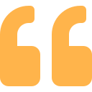
The Experiment
After Selling My Agency,
I Chose to Experiment Daily
Every experiment teaches me more about myself than about the tool.
Every day, one AI experiment. Documented openly.
Not tutorials. Not product reviews.
Personal confrontations with what AI changes about the way I work, think, and build.
— hugomelis.nl
30 experiments and counting · hugomelis.nl/experiments

Slide 3
Day 7
Running a Local Model to
Allow My Thoughts to Flow Freely
The Problem
The Approach
Hugo records voice memos on walks — raw, unfiltered thinking. But sending those to cloud AI means his most private thoughts become someone else's data.
Local Ollama models + OpenWhisper transcription. Nothing leaves the machine. Privacy becomes infrastructure, not policy.

Slide 4
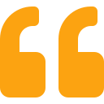


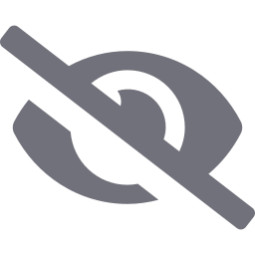
Day 7 · Key Insight
Privacy is not about neighbors looking through the window. It is about how freely I allow my thoughts to wander.
Maximum experimentation, minimal exposure. Local models let Hugo think out loud without self-censoring — the trade-off between capability and surveillance dissolves.
Cloud
Local

Slide 5
Day 10
Troostwijk Auction Search Sucks.
Let's Fix That.
The Trigger
The Build
The Result
Misspelled auction listings ("mutliplank" instead of "multiplank") meant deals went unnoticed by other bidders.
Used Codex /plan mode + Docker. A bot that finds partial matches and misspellings on Troostwijk automatically.
Found auction deals invisible to normal search. A working prototype in about 2 hours of focused effort.

Slide 6
Day 10 · Key Insight
As AI gets better, my inspection threshold lowers. Leverage increases. Visibility decreases.
Before
After
Review every line of code.
Question each architecture decision.
Maintain full comprehension.
Skim the plan. Trust the structure.
Contain the environment, not the decisions.
Surrender comprehension for speed.

Slide 7
Day 19
Building My Own CRM:
Can the Vision Survive?
The Old Way
The AI Way
Rough idea → wireframes → designer back-and-forth → developer builds → realize it's not right → more revisions. Weeks pass. Budget runs out before the vision lands.
Skip wireframes entirely. Claude Cowork in Figma produces full-fidelity designs in a few iterations. The vision holder becomes the builder. No translation layer.

Slide 8
Day 19 · Key Insight
The cost of translating an idea into a working product has dropped to almost zero. We don't know what this means yet.
After years running an app agency, the gap between what Hugo envisioned and what got built was always wide. AI collapses that gap. The question shifts from "can I build it?" to "is this what I actually want?"

Slide 9

The Hidden Pattern
Every experiment follows the same loop:
01
02
03
Control
Confrontation
Self-Knowledge
Set up the experiment. Define the question.
Run into what AI actually does vs. expectations.
Learn something about how I work, not just the tool.
hugomelis.nl/experiments

